Slide 1
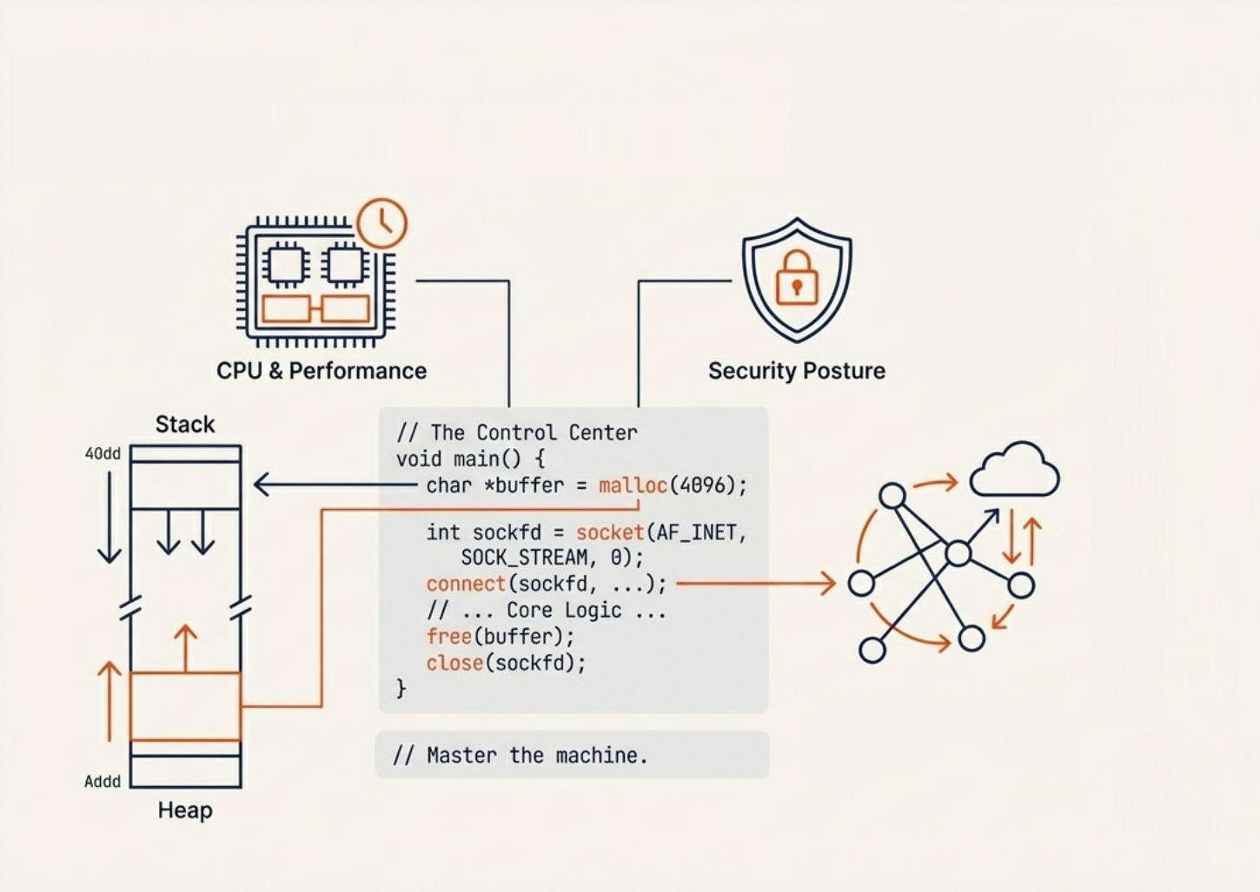
Operating System Essential for Developers
Nguyen Thi Binh An
D&A Development Team
LG CNS Vietnam Build Center

Slide 2
#1: Introduction #2: CPU Scheduling #3: Memory Management #4: File System #5: Socket & Networking #6: Environment Configuration #7: Practical Examples

Slide 3
#1: Introduction
Operating System – The world beneath your code

Slide 4
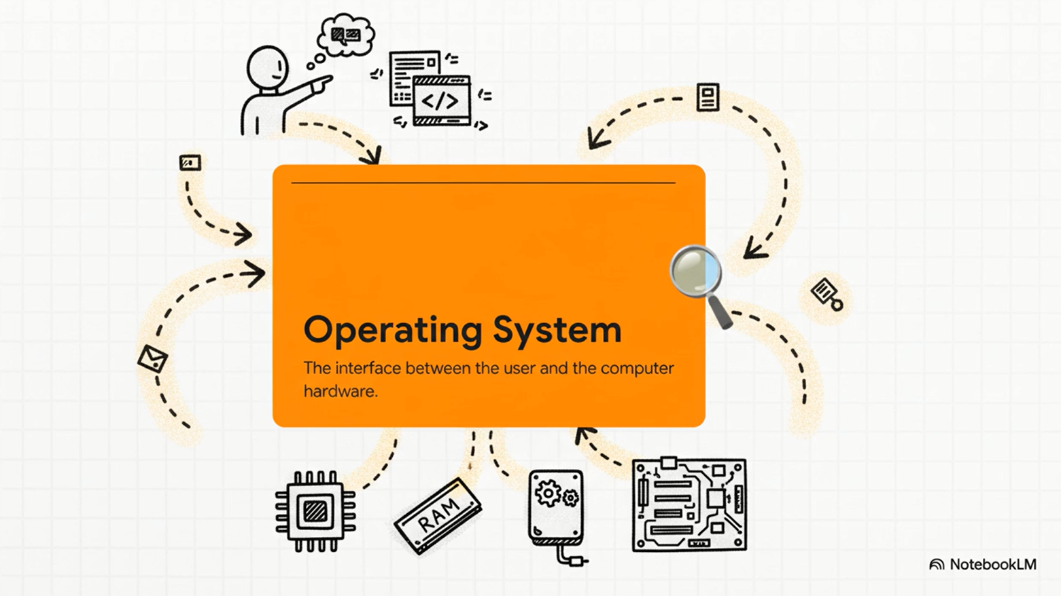
Operating System Fundamentals
Practical software development daily challenges

Slide 5

Operating System Roles
A program provide an easy way to execute application program, interface between apps and computer hardware
Resource manager : CPU, Memory, I/O Devices …
Provide set of utilities system functions to facilitates and simplifies application programing

Slide 6
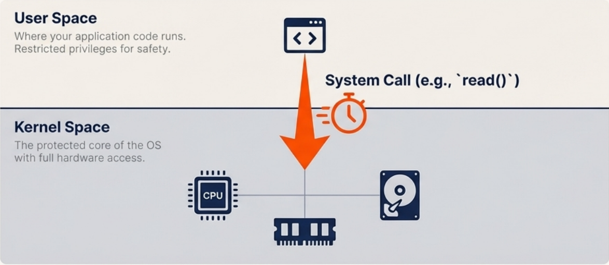
Operating System Fundamentals
Practical software development daily challenges

Slide 7
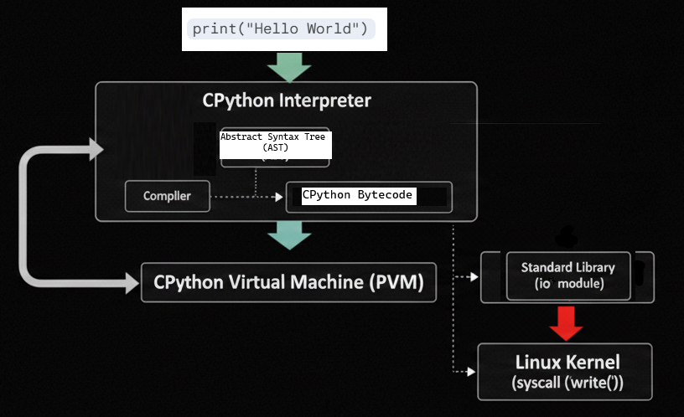
System Call Definition
The programming interface called applications, the bridge between User Mode and Kernel Mode, so the application can interact
Excessive system calls in tight loops cause performance issues.

Slide 8
#2: CPU Scheduling
How the brain of computer executing the code

Slide 9
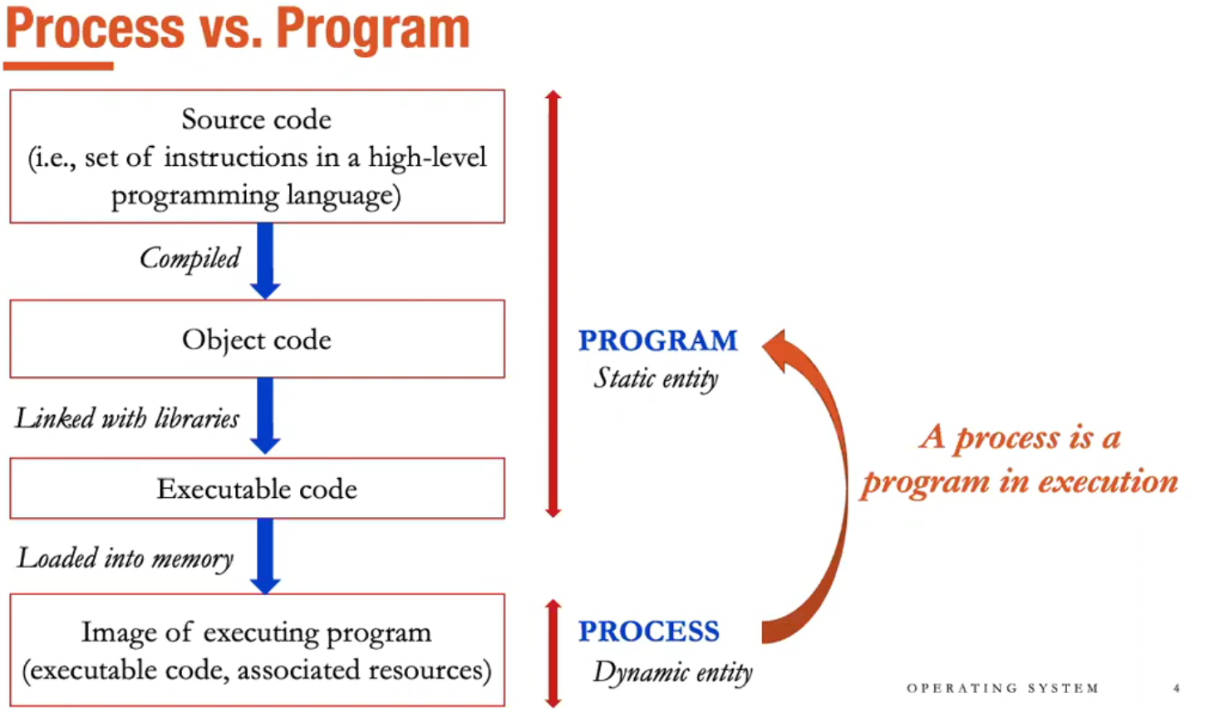

Slide 10
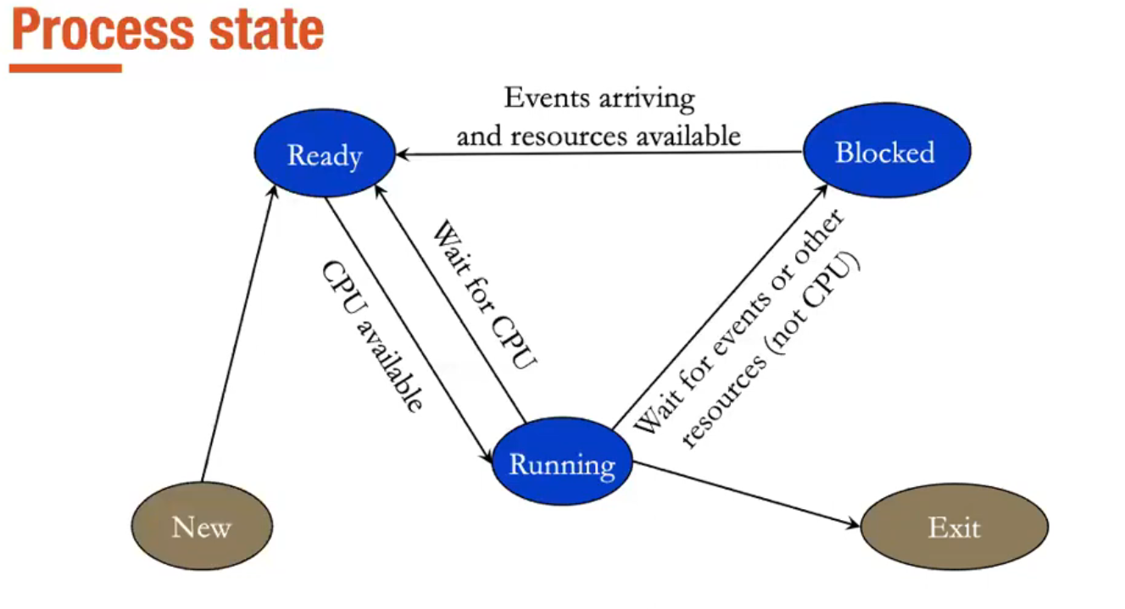

Slide 11
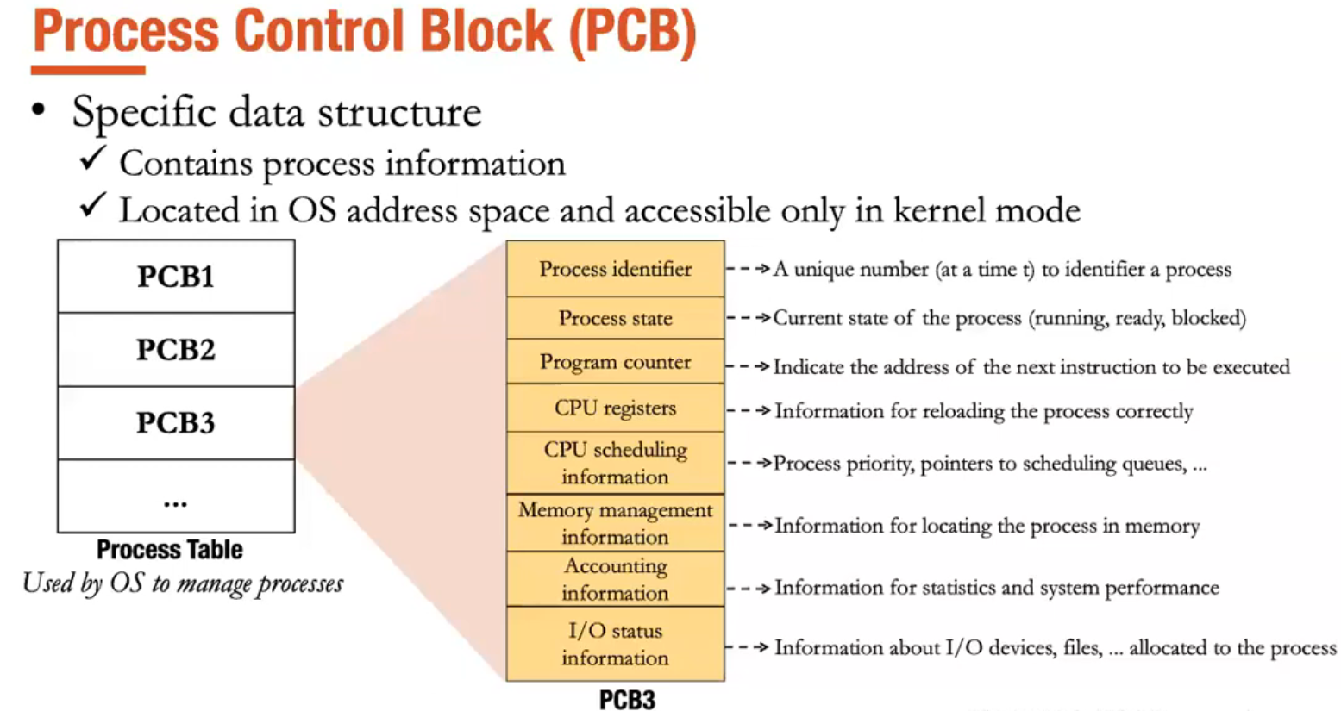

Slide 12
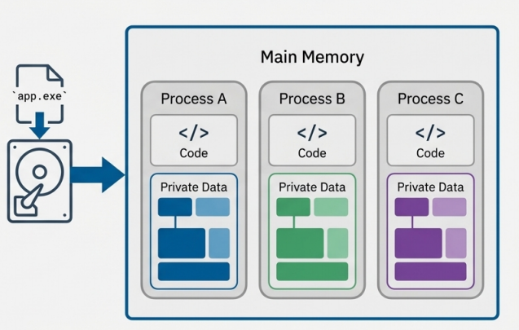
Understanding Processes
Core Concepts
- Process vs. Application: One application can spawn multiple independent processes.
- Lifecycle States: Creation, Running, Waiting, Terminated.
- Memory Protection: Every process operates in isolated memory space.

Slide 13
Why It Matters
Process Isolation & Safety
- Your application runs as a (or many) distinct process.
- Isolation allows the OS to contain crashes.
- Critical for debugging memory leaks and segmentation faults.
- Inter Process Communication (IPC) : ways of processes for exchanging data or collaborating to solve a task

Slide 14


Slide 15
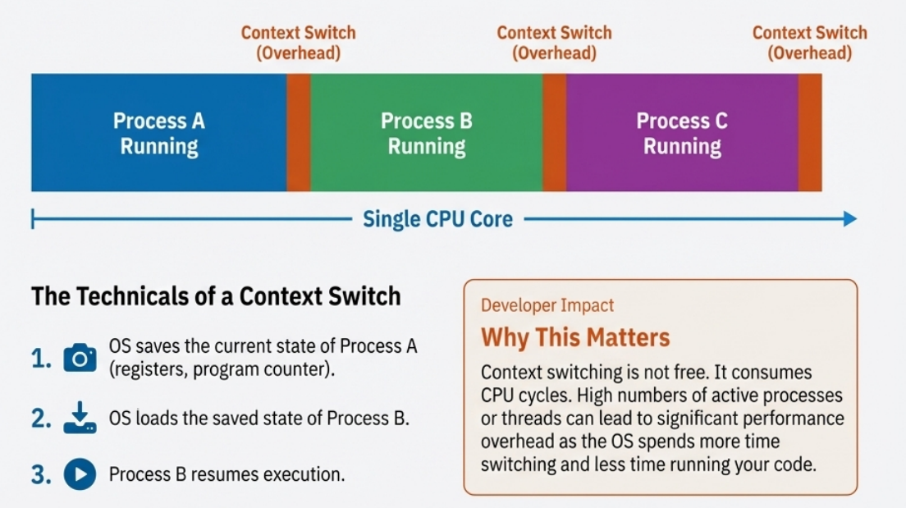

Slide 16
Process Creation & Termination
Parent process create children process
Child process may be duplicate of its parent (same memory space) or load another program to execute
A process may terminate when finished its execution or be terminated by its parent or OS processes

Slide 17
Inter Process Communication (IPC)
Pipe: Ordinary Pipe & Named Pipe
Shared Memory
Socket:
identified by an IP address and port number
UDP vs TCP

Slide 18
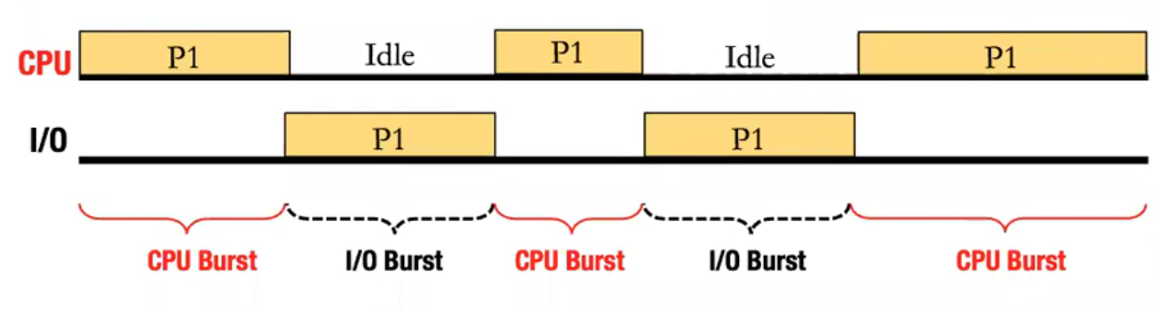
CPU Burst I/O Burst Cycle
A process execution alternates between:
CPU Burst performing calculations
I/O Burst performing I/O operations

Slide 19
CPU Scheduling
Scheduling Types:
Non Preemptive
Preemptive
Scheduling Algorithms:
First Come First Serve
Round Robin
Shortest Job First / Shortest Remaining Time Next
Priority / Multilevel Priority
Current OS often use mixed types

Slide 20


Slide 21
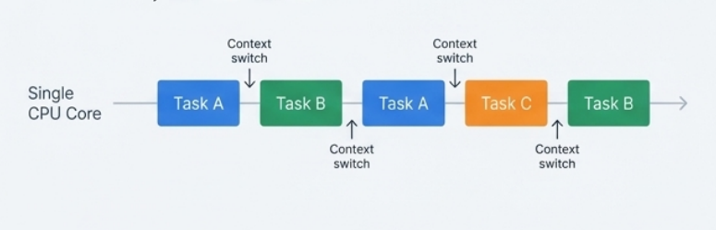
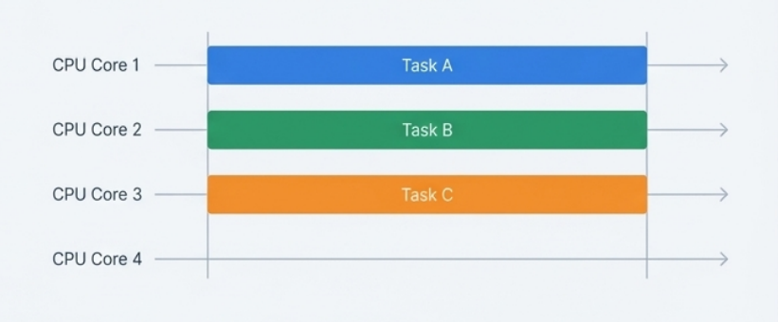

Slide 22
Example Code
Parallel vs Sequential
Processing Overhead:
Process creation and management
Inter-process communication (IPC)

Slide 23
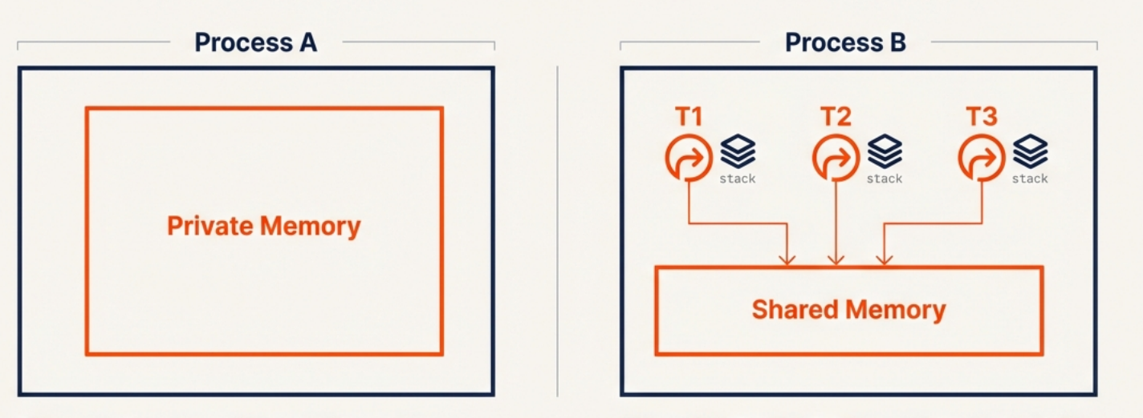
Threads vs. Processes

Slide 24
Threads vs. Processes
Key Distinctions
- Threads share the same memory space within a process.
- Resource Sharing: Threads share code, data, and files.
- Overhead: Threads are 'lightweight'; faster creation than processes.
- Risk: A bug in one thread can crash the entire process.

Slide 25
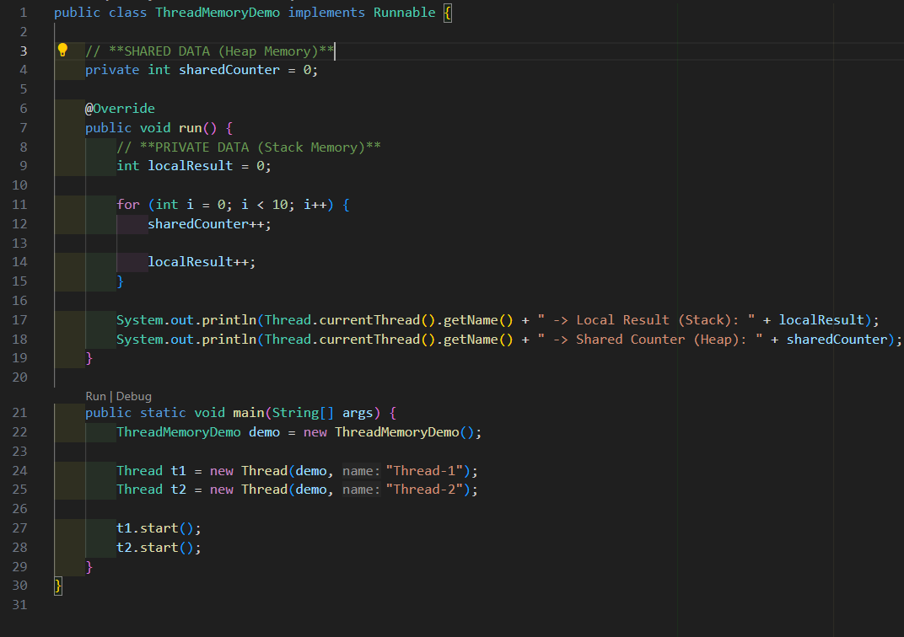

Slide 26
Synchronization Challenges
- Race Conditions: Simultaneous access leads to unpredictable outcomes.
- Deadlocks: Threads wait indefinitely for each other to release resources.
- Context Switching: CPU overhead when switching threads.

Slide 27
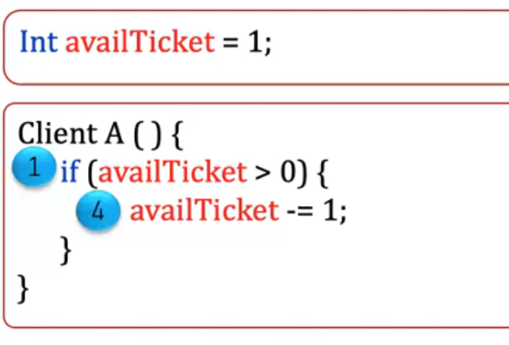
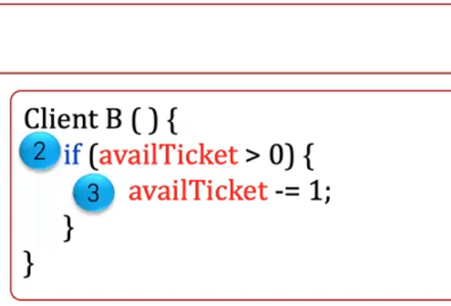
Race Condition
Shared variable is accessed by several processes/threads concurrently
-> Data Inconsistency
**Critical Section

Slide 28
Synchronization Requirements
Mutual Exclusion: Only one process/ thread can be executing inside a critical section at a time
Progress: A process/thread outside a critical section can not block others to enter this critical section
Bounded Waiting: Processes/threads should not wait infinitely for entering a critical section

Slide 29
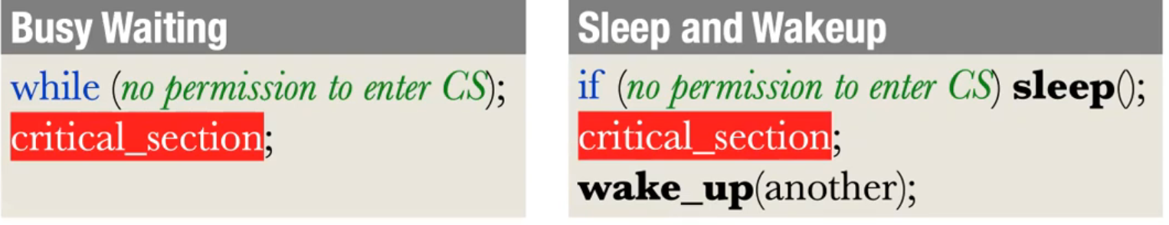
Synchronization Solutions
Inefficient
CPU wasting
Priority Inversion
Efficient
Semaphore
Monitor (thread-safe)

Slide 30
Example Code
Semaphore
Monitor
(thread-safe)

Slide 31
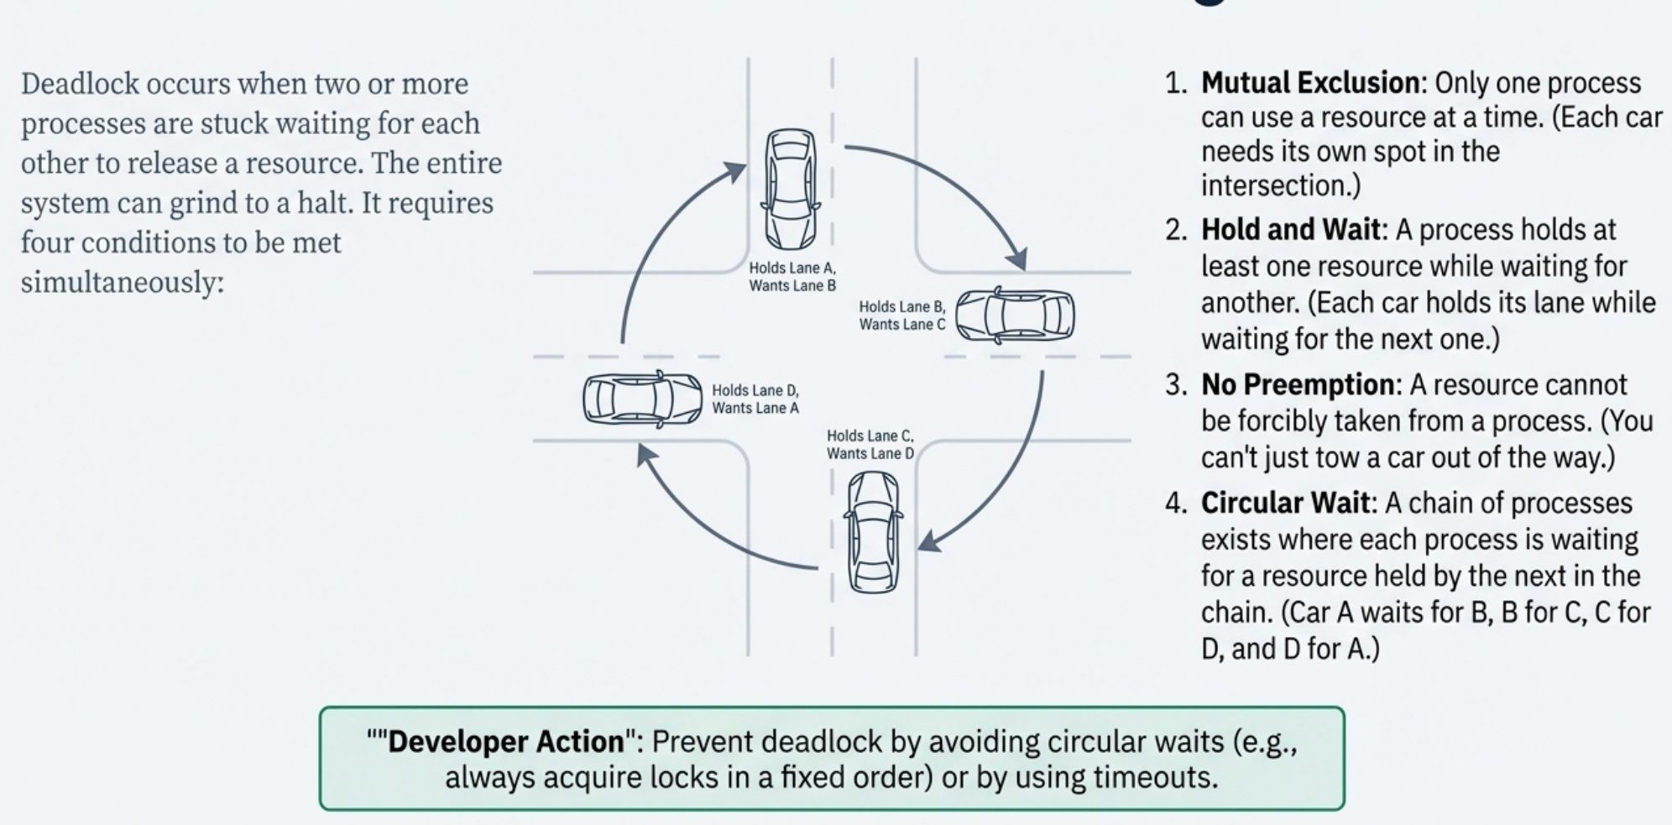

Slide 32
Deadlock
4 Conditions for Deadlock:
Mutual Exclusion: Resources must be non-shareable. Only one process/thread can use a resource at a time.
Hold and Wait: A process must be holding at least one resource and simultaneously waiting to acquire additional resources currently held by other processes
No Preemption: A resource cannot be forcibly taken away from a process; it can only be released voluntarily by the process holding it, after it has completed its task.
Circular Wait: A set of waiting processes/threads must exist such that P0 is waiting for a resource held by P1, P1 is waiting for a resource held by P0, ...
Definition: the situation when a set of processes or threads are all waiting for a resource that is currently held by another process or thread in the same set.

Slide 33
Deadlock Handling
Ignorance
Prevention
Avoidance
Detection &Recovery

Slide 34
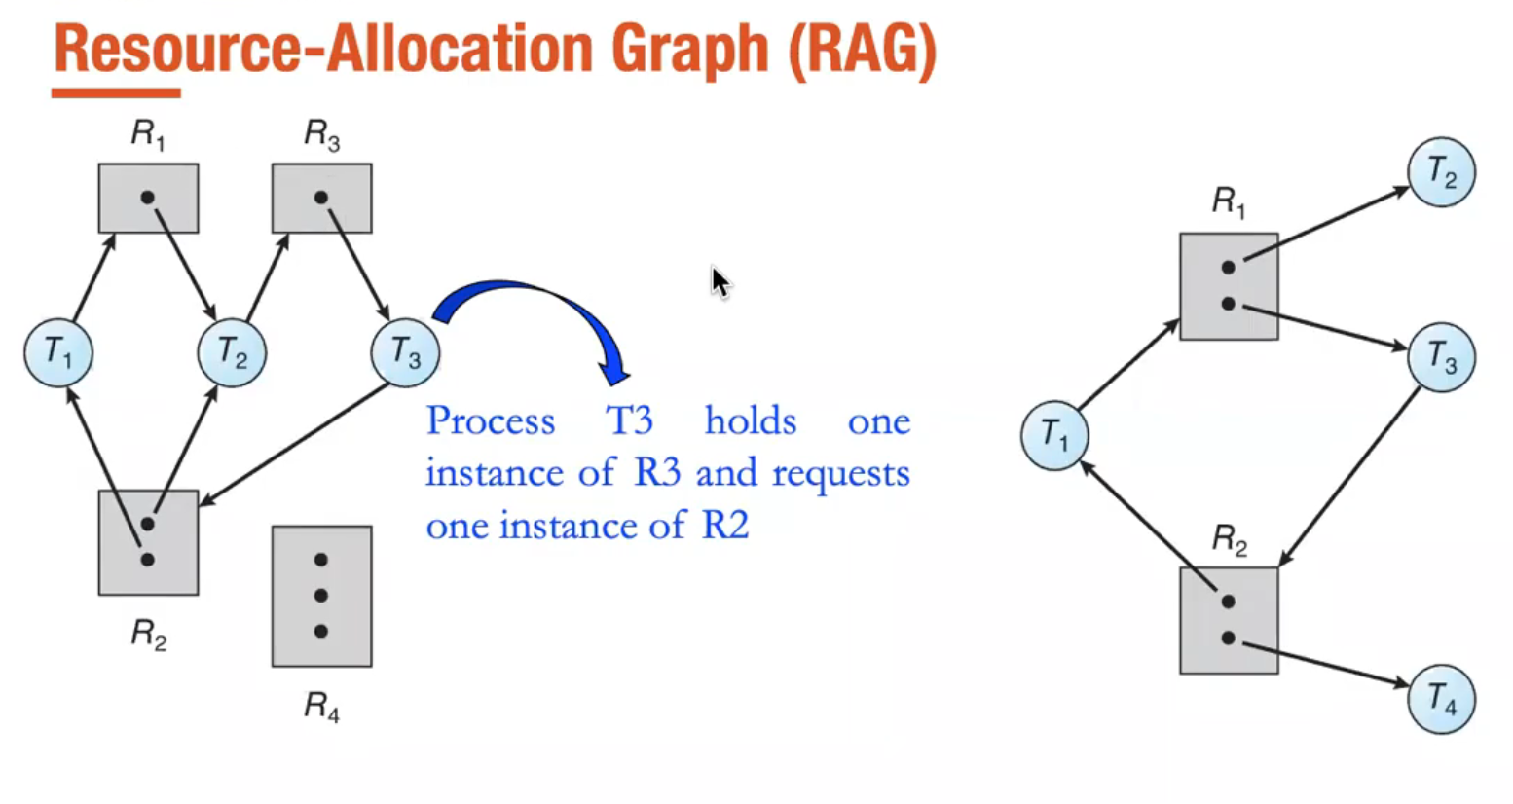

Slide 35
Example Code
Deadlock
No deadlock

Slide 36
#3: Memory Management
Where the process living

Slide 37
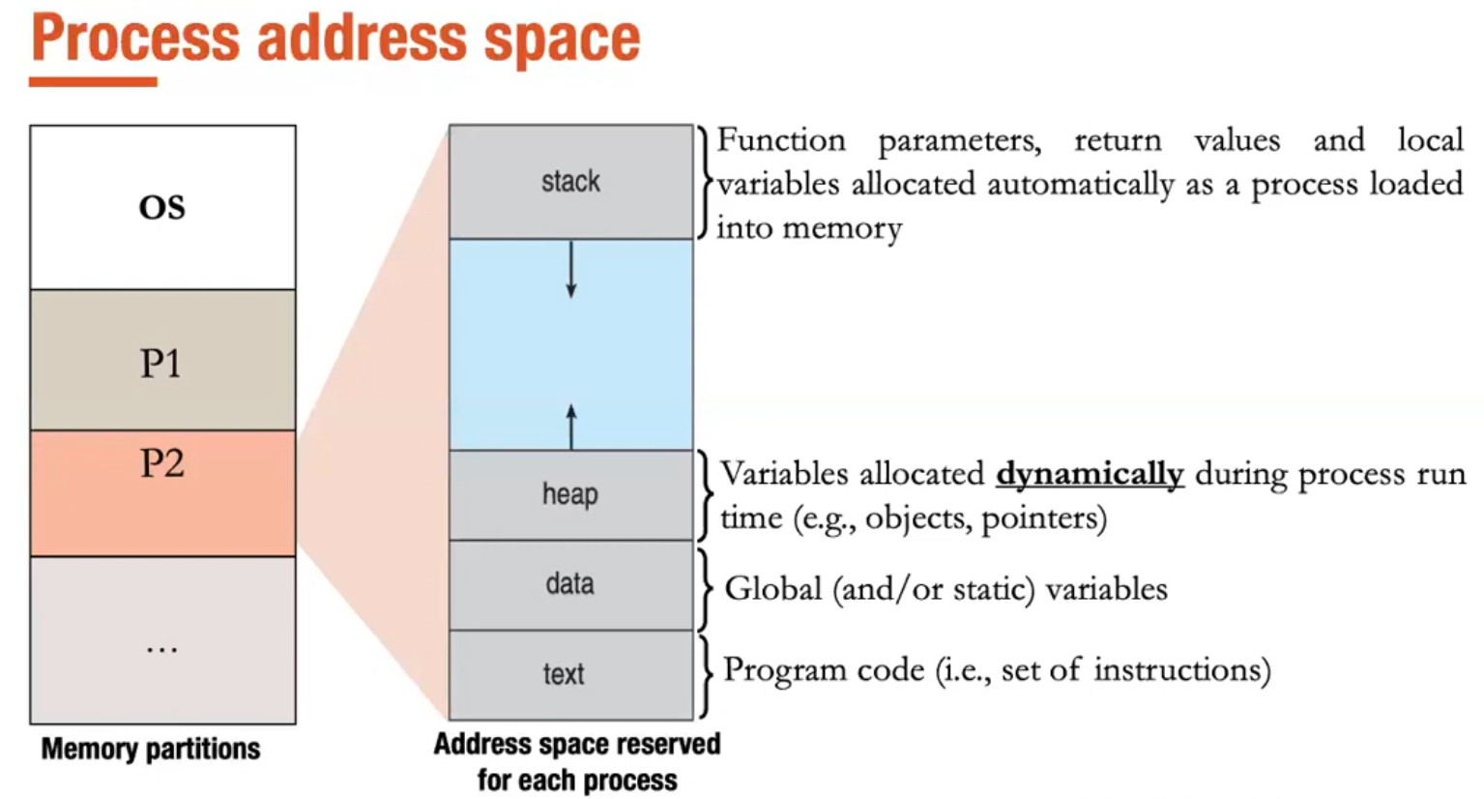

Slide 38
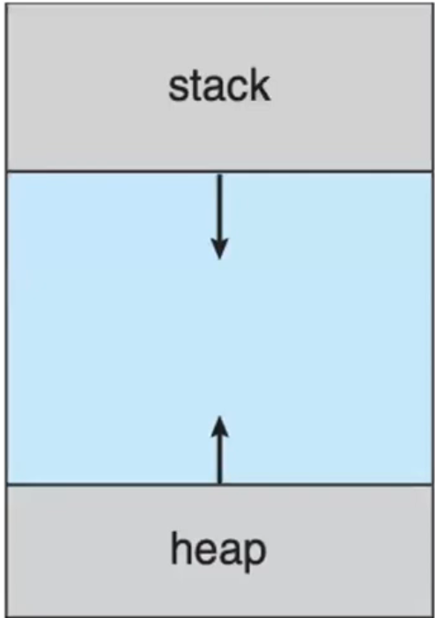
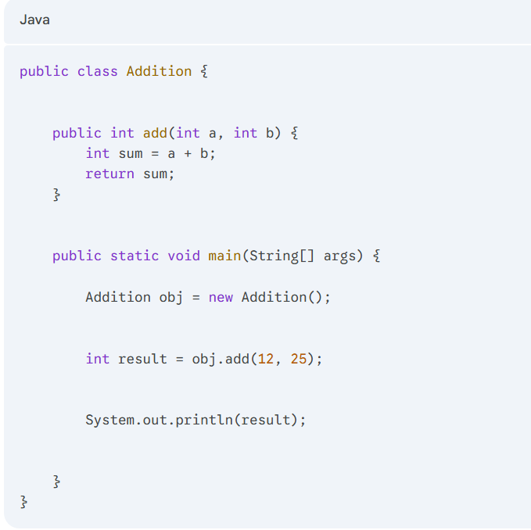

Slide 39
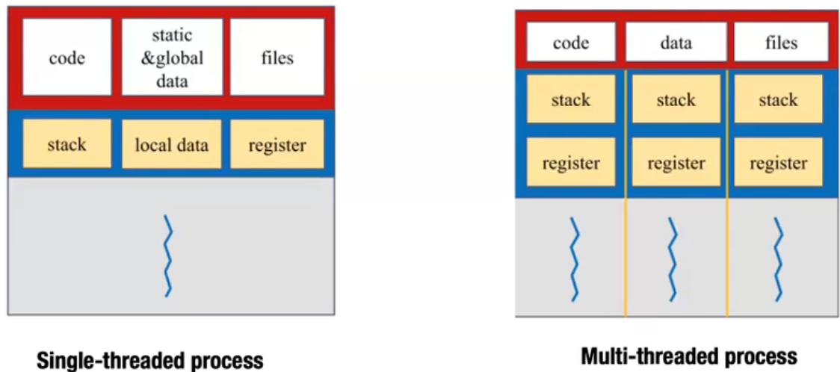
Threads vs. Processes

Slide 40
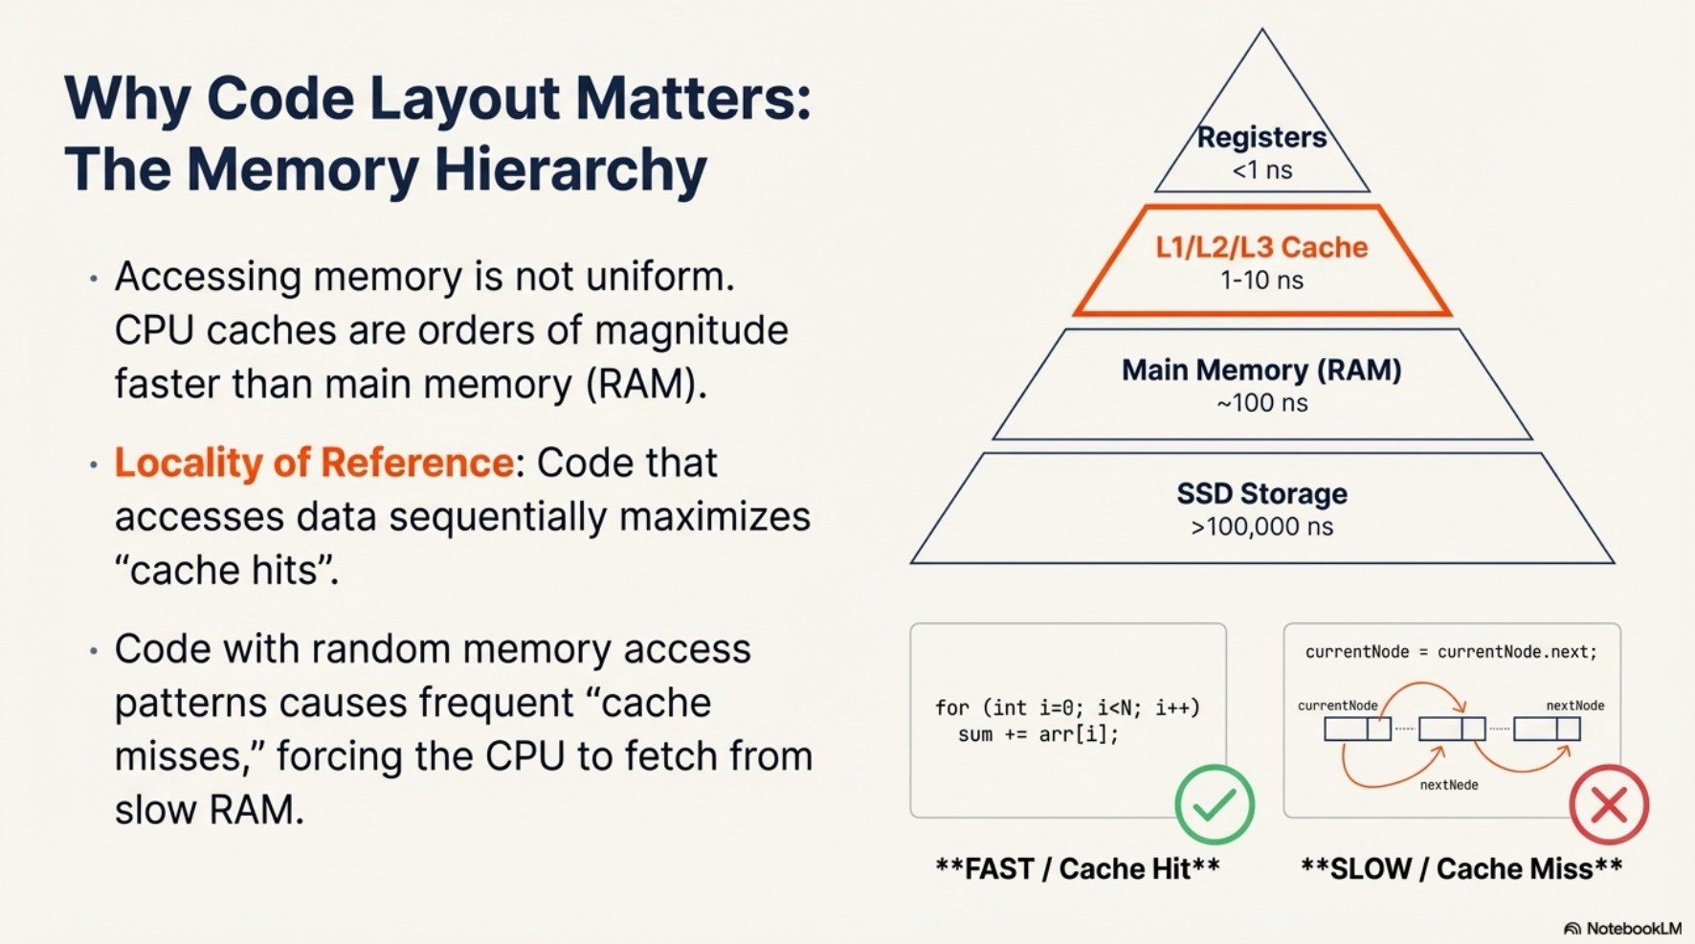

Slide 41
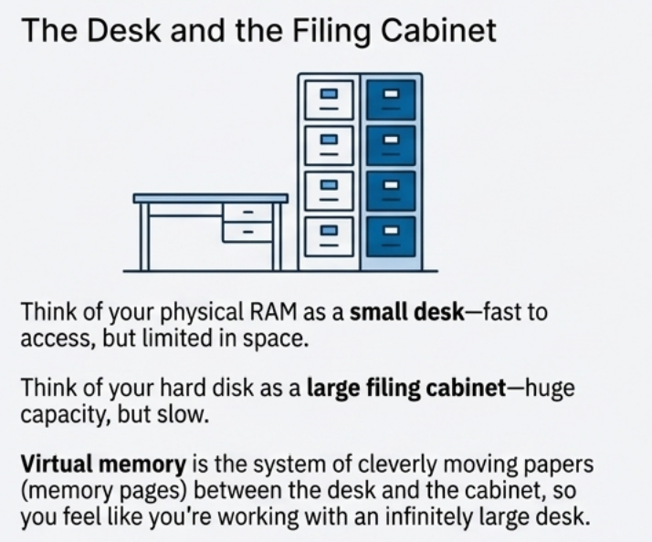

Slide 42
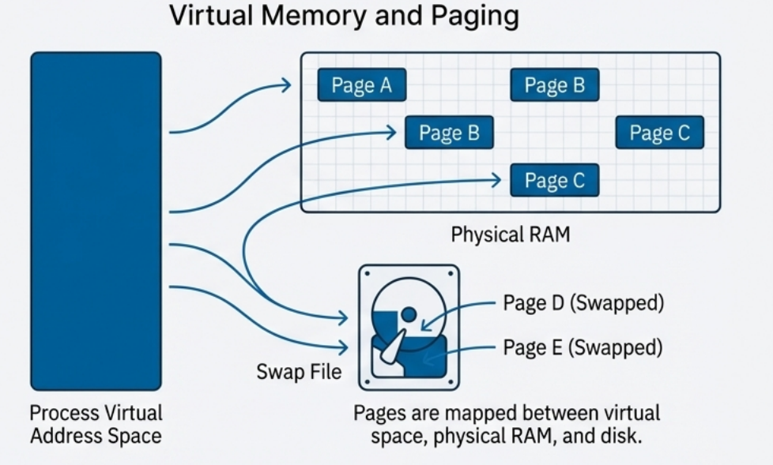

Slide 43


Slide 44
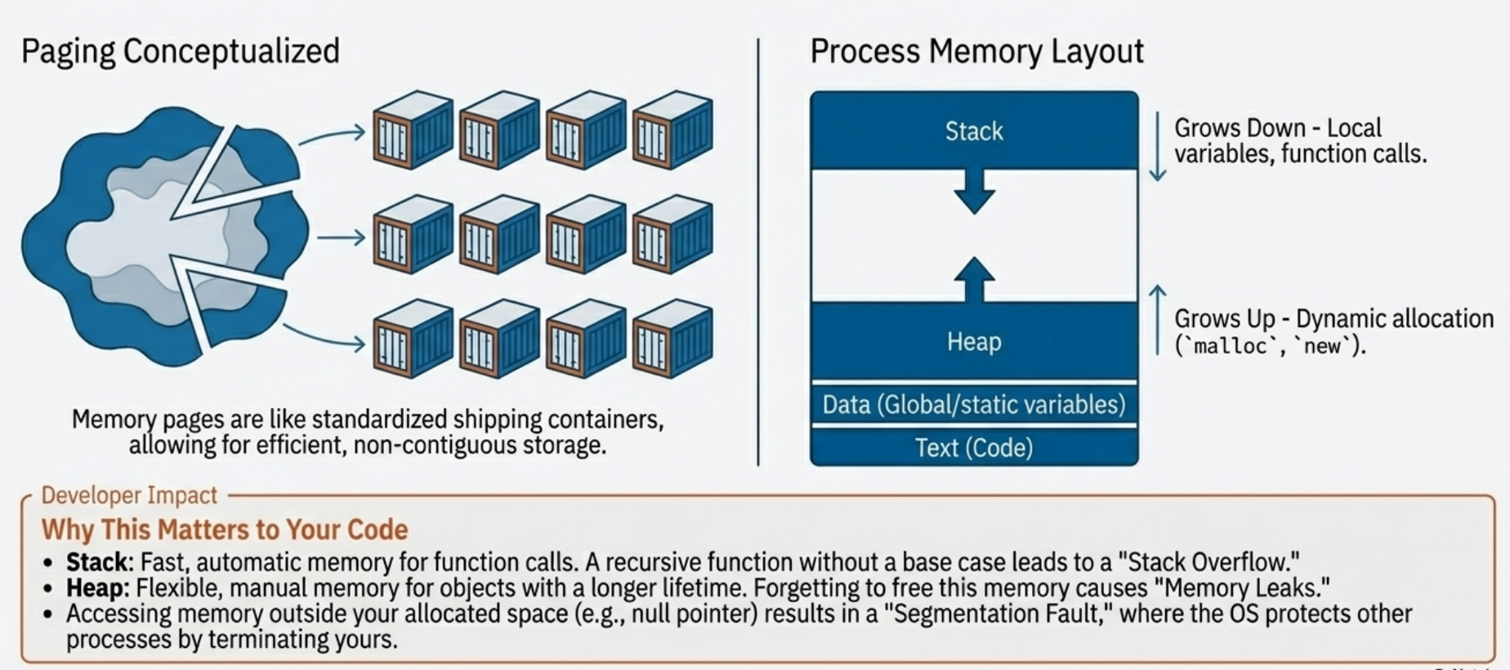

Slide 45
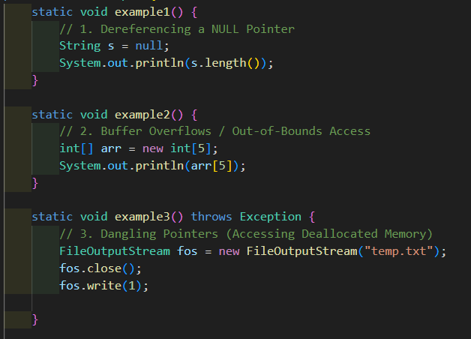
Common Causes of Segmentation Fault
Derefencing a Null Pointer
Buffer Overflows
Dangling Pointers

Slide 46
Example Code
Stack Overflow
Memory Leak
Poor Cache

Slide 47
#4: File System
Long-term & large disk space

Slide 48
File Operations / System Calls
I/O methods (file.read(), file.write()) are wrappers around OS system calls like open, read, write, seek, and lock. -> debug file corruption and concurrency issues.

Slide 49
File Access Methods
The OS supports two critical access methods for applications:
Sequential Access: Reading/writing bytes in order (e.g., writing log files, reading a network stream).
Direct / Random Access: Reading/writing specific blocks of data non-sequentially. This is the foundation for all databases (e.g., MySQL, PostgreSQL, MongoDB), making it highly relevant for data persistence.

Slide 50
Directory Structure
Most modern operating systems use a Tree-Structured Directory (like Linux's / or Windows' C:\). -> Setting up relative paths in configuration files and deployed application bundles.

Slide 51
File Protection & Security
File protection is implemented using Access Control Lists (ACLs) or simplified permissions. For servers running on Linux (Ext4), this is the rwx (read, write, execute) model.
octal permissions (e.g., chmod 755 or chmod 600) to secure configuration files, private keys, and data directories to prevent unauthorized access by other users or processes on the server.

Slide 52
File Allocation Methods (i-nodes)
The most common method on modern Linux systems is Indexed Allocation (which uses i-nodes). This structure is important for understanding why certain file metadata operations are fast and how disk fragmentation can affect application I/O performance.

Slide 53
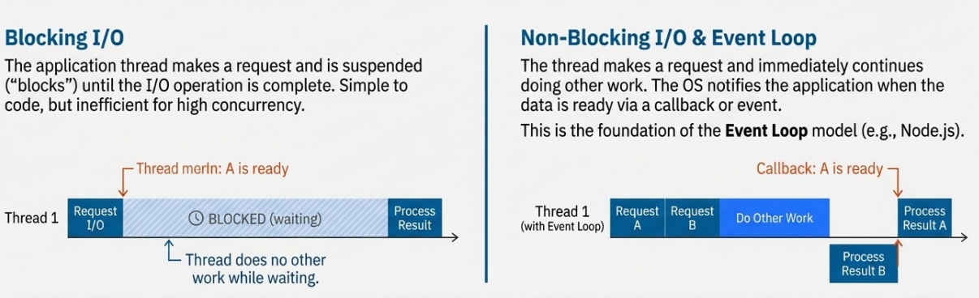

Slide 54
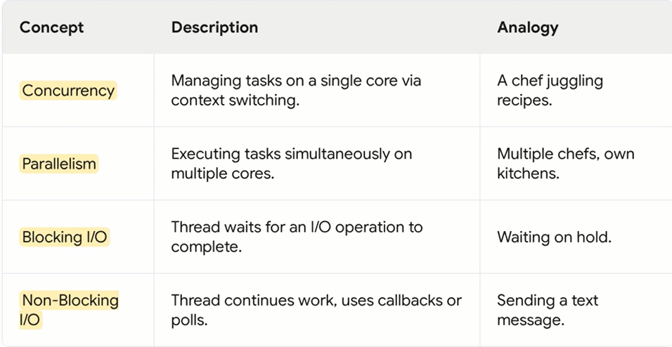

Slide 55
Example Code
Blocking vs Non Blocking I/O

Slide 56
User-Kernel I/O Boundary
All I/O operations executed in your application must cross the boundary from User Mode to Kernel Mode via a System Call
Software Layers: Application code uses User Level Libraries. These library functions translate your request into a system call to the OS kernel.
Kernel Mediation (System Calls): A software interrupt (or Trap) is generated to transfer control from your user application to the OS kernel. The kernel then takes over, handling the device-specific request using its Device Driver.
Abstraction: The OS provides a universal Device Independent Software layer that uses generic functions (like read or write) to abstract away the complexity of different physical devices (like hard drives vs. network cards). This is why the same I/O function can be used for files or sockets.

Slide 57
High-Performance I/O Models (Interrupts and DMA)
The OS uses different techniques to manage I/O, which dictates the performance characteristics of your application's I/O calls. These models explain the difference between blocking and non-blocking/asynchronous operations.

Slide 58
Interrupt-Driven I/O (Enables Non-Blocking)
This is the fundamental mechanism that allows a backend server to handle many concurrent connections without the CPU getting stuck waiting for one slow I/O operation.
The Wait: The CPU issues an I/O command and immediately moves on to execute other work (doing something else) The process that requested the I/O is typically put into a waiting/blocked state.
The Notification: When the hardware device completes the I/O operation (e.g., a network packet arrives), the device controller issues a hardware Interrupt to the CPU
Outcome: This mechanism maximizes CPU utilization. In Node.js, this is key to the single-threaded event loop. In Java and Python, it allows frameworks/libraries (like Netty or asyncio) to schedule other tasks while waiting for I/O completion.

Slide 59
Direct Memory Access (DMA) (Enables Fast Data Transfer)
DMA is crucial for reducing CPU load during large data transfers, which is common in high-throughput backend services (e.g., streaming large files or handling high-volume network traffic).
Bypassing the CPU: After the CPU initiates the I/O operation, the DMA Controller takes over the data transfer. Data is moved directly from the device (e.g., a network card) to the main memory (RAM) without passing through the CPU registers byte-by-byte
The Single Interrupt: The DMA controller issues only one interrupt to the CPU when the entire block of data transfer is complete, instead of interrupting for every small I/O buffer
Outcome: This significantly reduces the overhead on the CPU and is the basis for high-efficiency I/O, often referred to as "Zero-Copy" in high-performance networking architectures.

Slide 60
#5: Socket & Networking
Most common way of Inter Process Communication

Slide 61
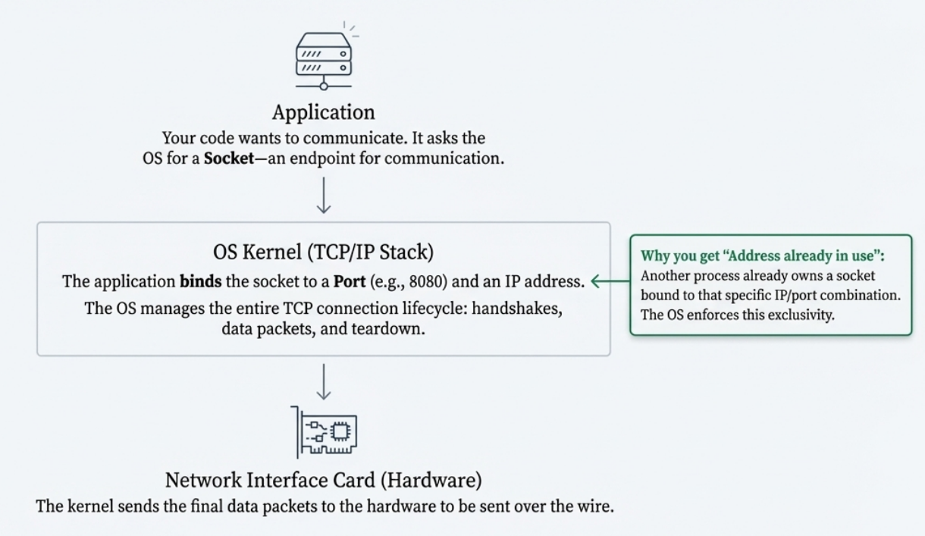

Slide 62
Network Stack
Kernel network buffers and TCP settings
Send/receive buffers and throughput tuning
TCP_NODELAY, SO_REUSEADDR, TCP_KEEPALIVE

Slide 63
Sockets
Socket creation and lifecycle
Connection states: LISTEN, ESTABLISHED, TIME_WAIT
TIME_WAIT and port exhaustion issues

Slide 64
Network Performance Tuning
TCP backlog (listen queue): Impact on connection acceptance
Connection timeouts: TCP timeout vs application timeout
Nagle's algorithm and latency

Slide 65
#6: Environment Configuration
Modern Application Style

Slide 66
Environment Variables & Configuration
How OS passes environment to processes
Resource limits (ulimit): File descriptors, stack size, max processes
Shell environment vs systemd service environment

Slide 67
Configuration Best Practices
Setting appropriate file descriptor limits for servers
Configuring heap memory for containers
Thread pool sizing based on CPU count

Slide 68
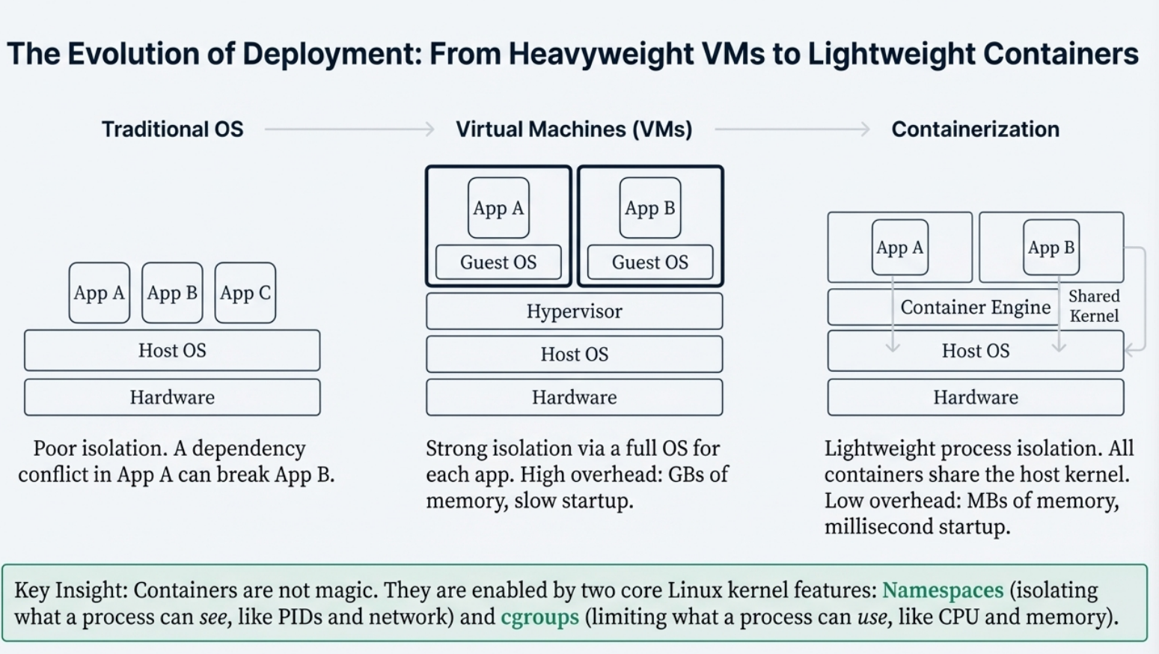

Slide 69
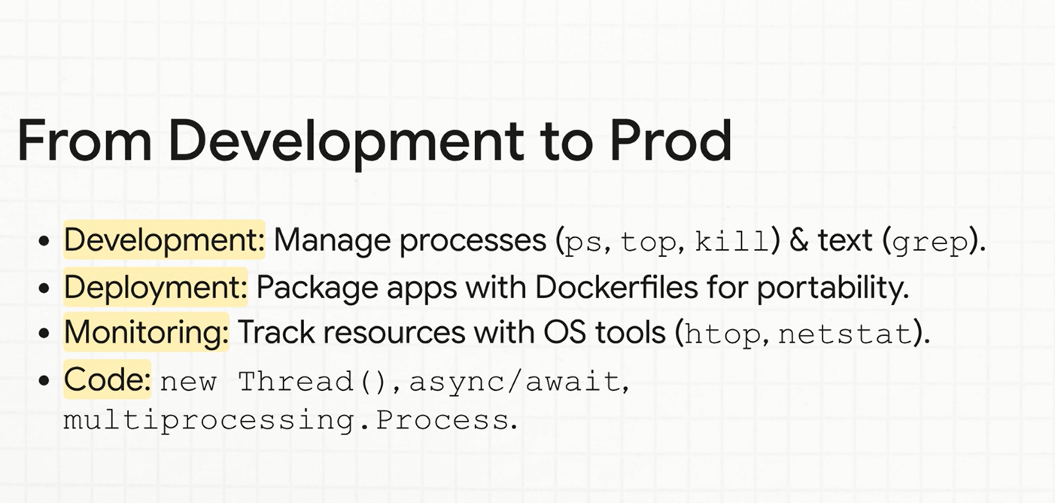

Slide 70
#7: Practical Examples
And how to handle it in specific Programing Languages

Slide 71
I/O Bound problems
Efficient synchronous/asynchronous, & non-blocking code.

Slide 72
CPU Bound problems
XXXX

Slide 73
Language Specifics
Java: JVM threads map to OS threads (ExecutorService).
Python: Limited by GIL (Global Interpreter Lock). Use multiprocessing for CPU tasks.
Node.js: Single-threaded Event Loop. Use Worker Threads for CPU tasks.

Slide 74
Language Specifics
Java: Heap configuration (-Xmx, -Xms); garbage collection tuning
Python: Reference counting and garbage collection; memory profiling tools
Node.js: V8 heap size limits; memory leaks in event-driven code

Slide 75
Language Specifics
Java: FileInputStream / FileOutputStream vs buffered streams; NIO channels
Python: open() modes; buffering parameters
Node.js: fs module; stream API for efficient I/O

Slide 76
Language Specifics
Java: ServerSocket configuration; socket buffer settings
Python: socket module; asyncio for non-blocking sockets
Node.js: Server configuration; net module; stream backpressure

Slide 77
Language Specifics
Java: Thread count affects scheduling; JVM CPU usage patterns
Python: Multiprocessing for CPU-bound work to bypass GIL
Node.js: libuv thread pool size for blocking operations

Slide 78
Practical Examples
- Thread Pool Sizing: Balance pool size to match CPU cores.
- Async vs Threading: Async for I/O; Threading for CPU tasks.
- Monitoring: Track thread states and deadlock detection.

Slide 79
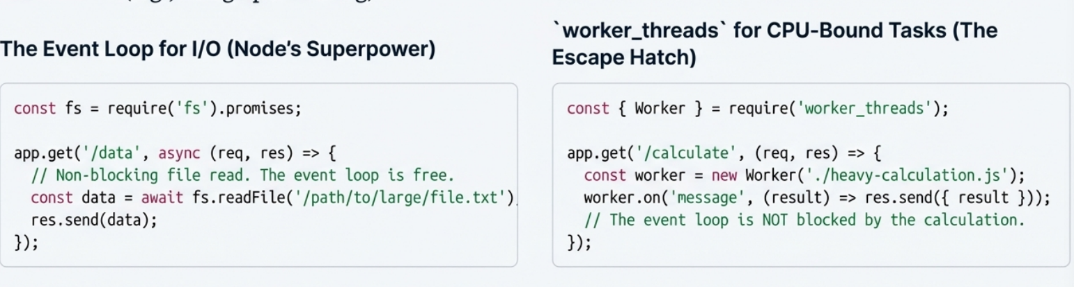

Slide 80
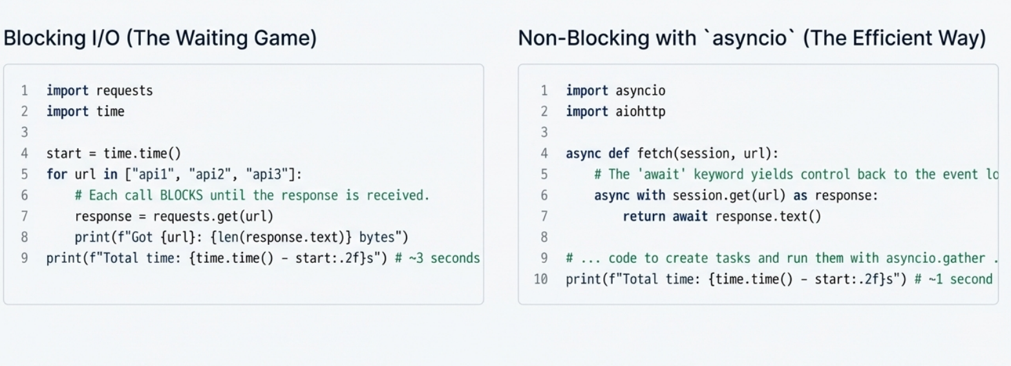

Slide 81
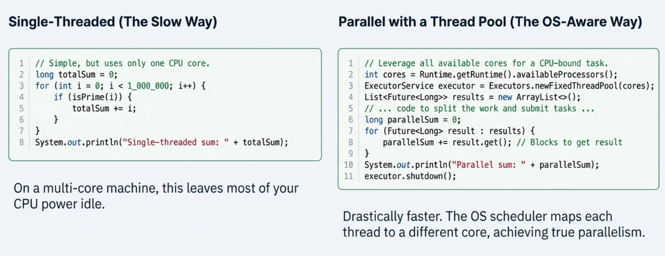

Slide 82
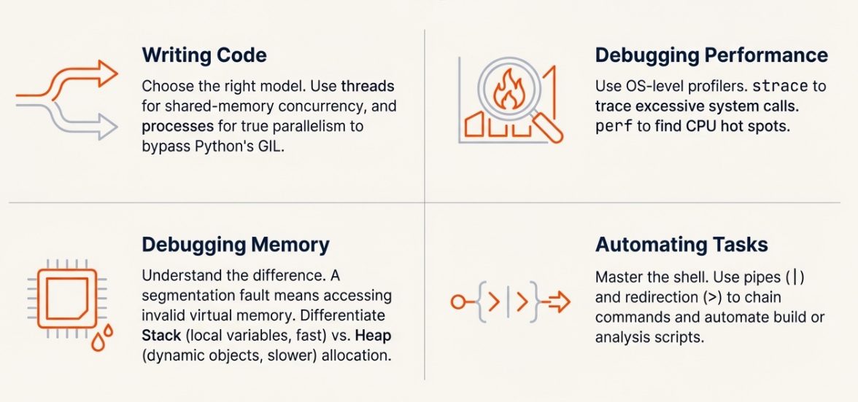

Slide 83
Thank you
I sincerely hope the time you spent was worthwhile and not wasted

Slide 84
Quiz and Q&A Time
I sincerely hope the time you spent was worthwhile and not wasted

